Slide 1
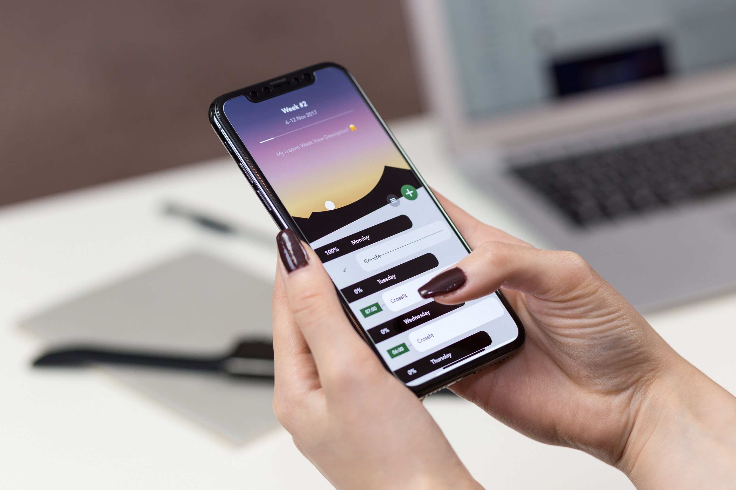
FCA PROJECT
Name of Project: Exploring Smartphone Brands and Usage Preferences.
Team: Sainath,Sukesh,Srinivas,Kartik,Nandini
Date: November 25th, 2024

Slide 2

Today's Agenda
I.Motivation | II. Introduction
III. Interface | IV.Methadology and Worflow

Slide 3
Motivation
Why This Study?
The smartphone market is ever-evolving, with numerous brands competing for user loyalty.
Consumers face challenges in choosing the right brand due to the vast variety of options and features.
This study aims to understand user preferences, satisfaction levels, and behavioral trends to provide actionable insights for consumers and manufacturers.

Slide 4
Introduction
Introduction
Exploring Smartphone Usage Patterns
.
The research explores smartphone brand preferences, satisfaction with features like performance and battery, and trends in app usage.
This study combines survey data and statistical analysis to identify user behavior and trends.
Key Objectives:
Analyze brand popularity and satisfaction levels.
Examine app engagement and screen time trends.
Provide insights for manufacturers to improve products.

Slide 5
Interface
How We Engaged with Participants
A survey-based approach was used to gather data from a diverse set of respondents.
Respondents provided information on:
Demographics: Gender, age, and course/section.
Smartphone usage: Current brand, duration of use, and satisfaction ratings.
Behavioral patterns: Most-used apps, screen time, and likelihood of recommending their brand.

Slide 6

Survey Creation:
A comprehensive survey was designed to collect data on smartphone preferences and usage.
Questions targeted demographics, brand satisfaction, app usage, and behavioral insights.
Data Collection:
Responses were gathered from participants and organized into structured datasets.
Data Analysis:
Tools like Excel were used to process the data.
Statistical techniques, including weighted averages and visualizations, were employed.
Methodology

Slide 7

Workflow
Start
Data Collection
Survey Distribution
Data Validation
Statistical Analysis
Insights Generation
End

Slide 8
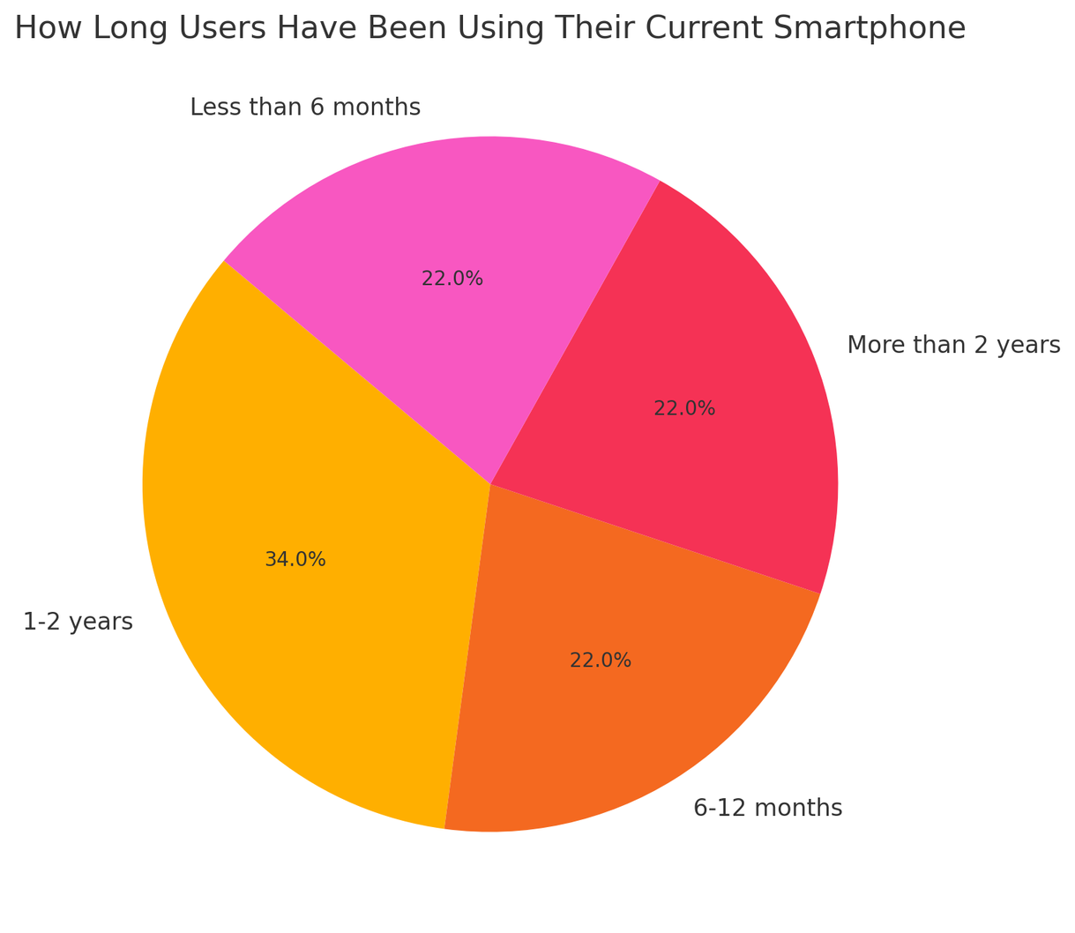
Statistics
Analysis of Pie Chart: Analyzing Smartphone Usage Duration"
Most respondents (50%) reported using their smartphones for 1-2 years, indicating it is the typical lifecycle before considering an upgrade.
Short-Term Usage:
30% have been using their devices for less than 6 months, likely reflecting new purchases or upgrades.
Long-Term Usage:
Only 20% have been using their smartphones for more than 2 years, possibly indicating high satisfaction or delayed upgrades.
Analysis:
Users with longer durations (e.g., more than 2 years) generally reported higher satisfaction, suggesting durable devices maintain user loyalty. Shorter durations often reflect dissatisfaction, leading to earlier replacements.

Slide 9
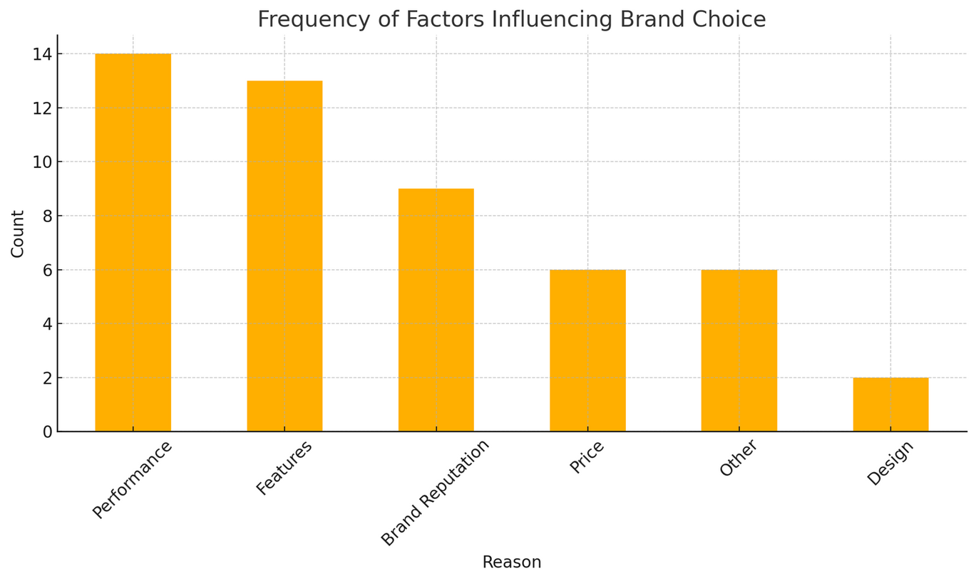
Factors Influencing Smartphone Brand Choice
Content:
•Performance:
•Users value speed, reliability, and smooth operation.
•Price:
•Budget-friendly options attract many users.
•Brand Reputation:
•Trust in the brand's quality and reliability is a key factor.
•Camera Quality:
•High-quality cameras are important for photo and video enthusiasts.
•Features and Design:
•Specific features like gaming capabilities, battery life, and sleek designs influence choices.

Slide 10
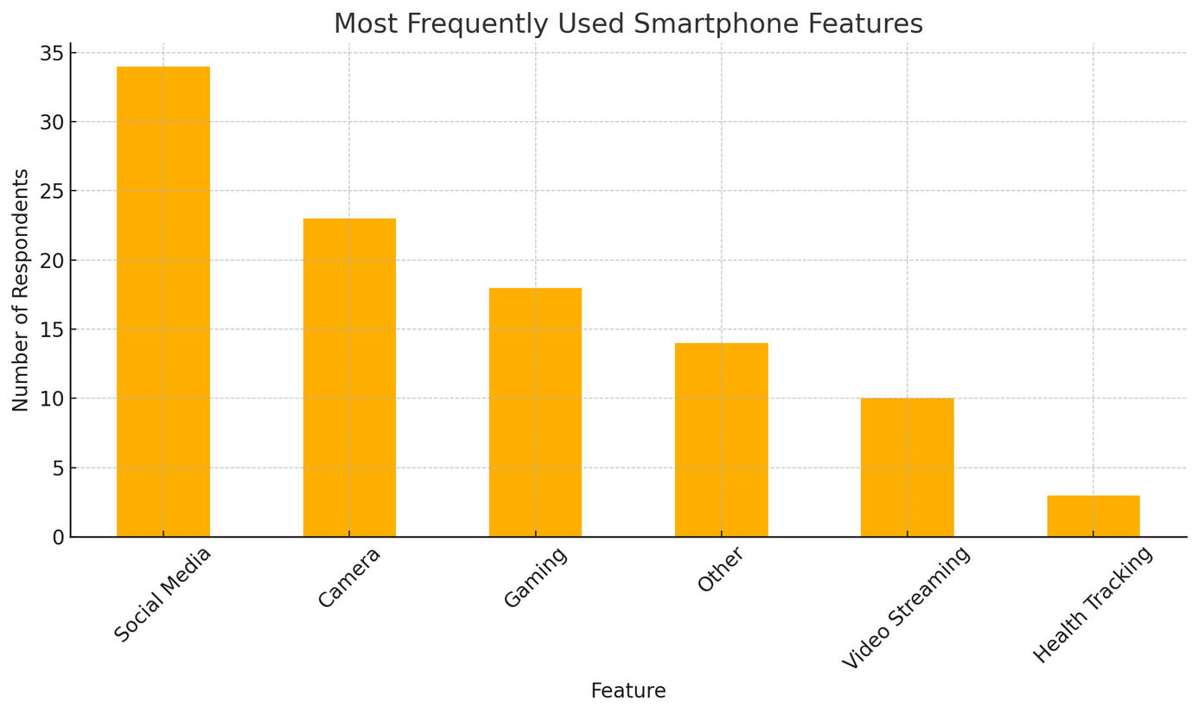
Most Frequently Used Smartphone Features
Key Insights:
Camera:
One of the most frequently used features, chosen by 30% of respondents, for photography and video recording.
Social Media:
Most users spend significant time on apps like Instagram, WhatsApp, and YouTube.
Gaming:
20% of users prioritize gaming capabilities, especially on devices with high performance.
Other Features:
Battery life, streaming, and productivity tools are also valued by some users.
Trends:
Camera and social media usage dominate, reflecting the importance of smartphones as tools for creativity and connection.
Gaming is a key feature for younger demographics or users looking for entertainment.

Slide 11
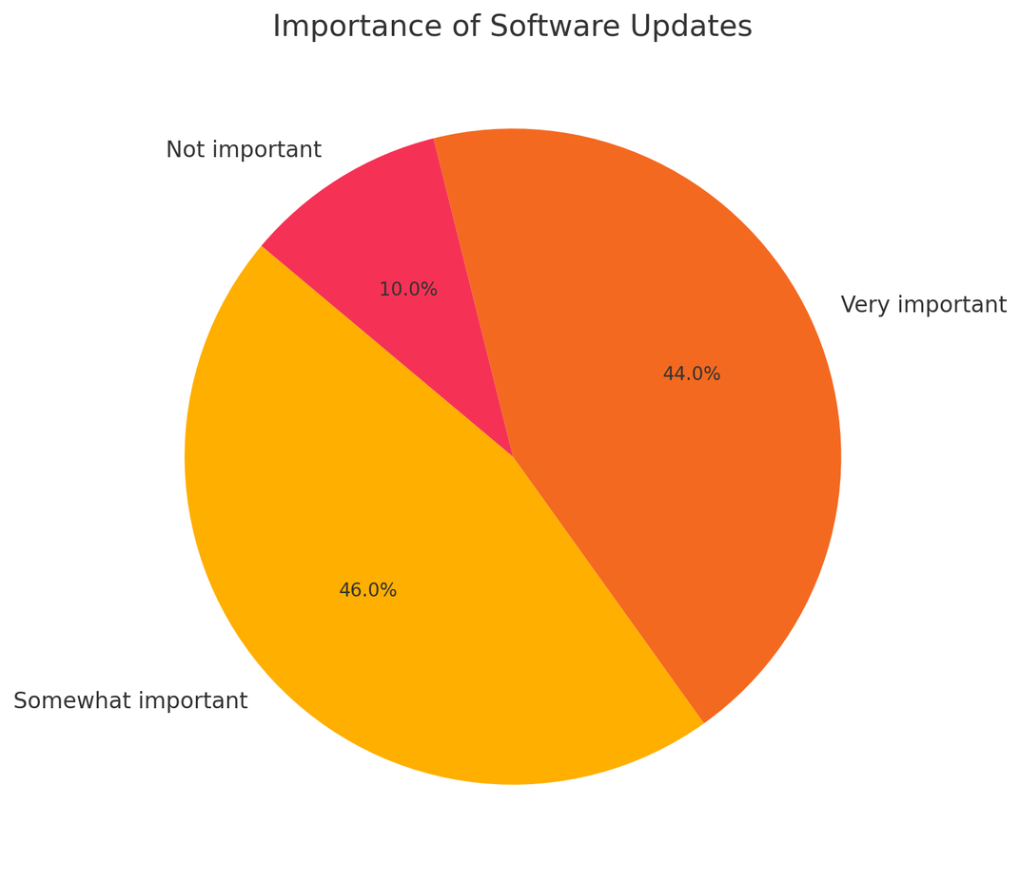
How Crucial Are Software Updates to Smartphone Users?
Key Insights:
Very Important:
50% of respondents consider software updates critical for security, performance, and access to new features.
Somewhat Important:
35% value updates but may not prioritize them as highly, especially for budget devices.
Not Important:
15% of users don’t see updates as a priority, often satisfied with existing features.
Trends:
Premium smartphone users (e.g., iPhone, Samsung) emphasize updates for reliability and security.
Users of budget-friendly brands may perceive updates as less critical due to shorter device lifespans.

Slide 12
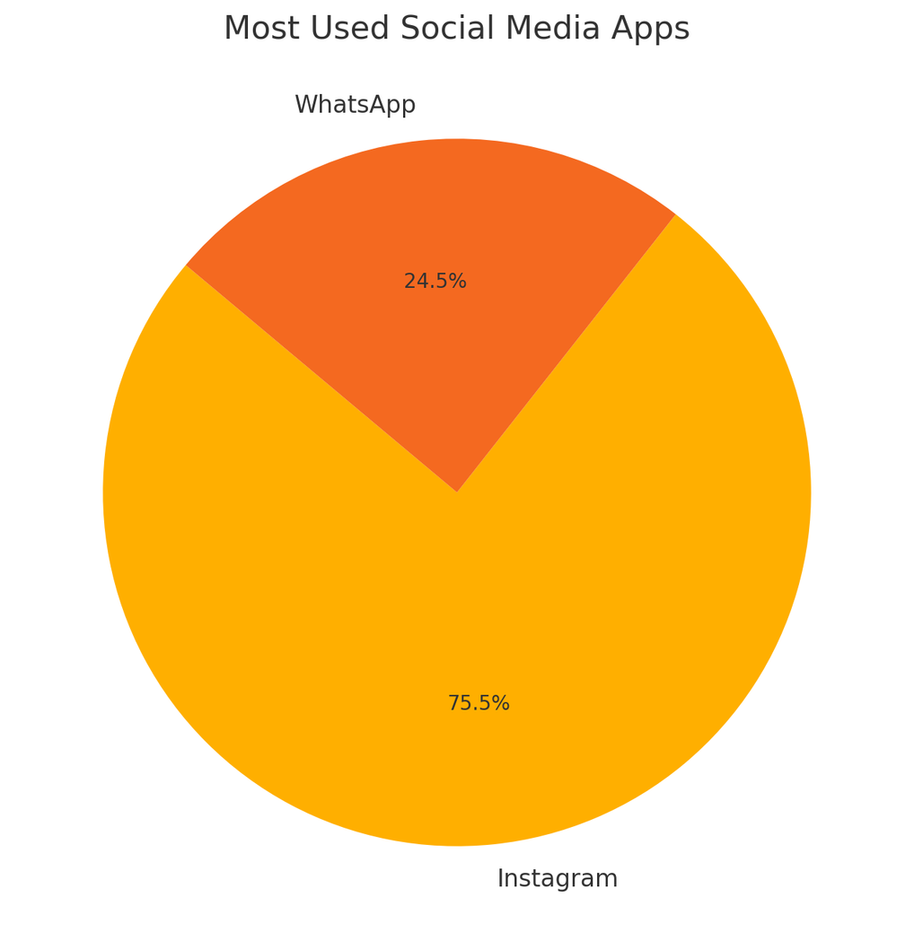
Most Popular Social Media Apps Among Users
Key Insights:
Instagram:
The leading app, used by 45% of respondents, indicating its dominance as a platform for photo sharing, reels, and social interaction.
WhatsApp:
Chosen by 30%, it remains popular for messaging and communication.
YouTube:
Used by 20%, it is a preferred app for video streaming and content consumption.
Other Apps:
Platforms like Spotify and Snapchat capture niche usage, representing 5% collectively.
Trends:
Instagram's dominance highlights its role as the go-to platform for entertainment and connectivity.
WhatsApp and YouTube are essential for communication and video consumption, respectively.
Other apps serve specific needs, reflecting varied user interests.

Slide 13
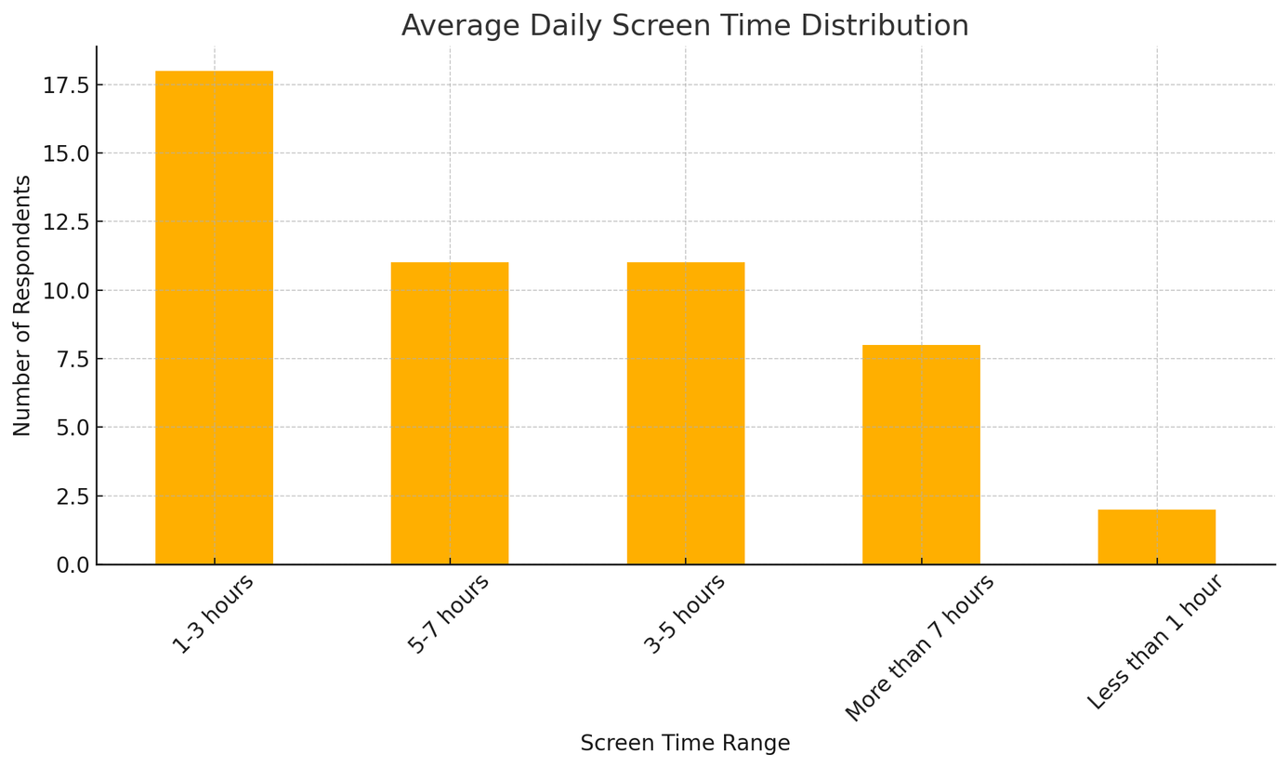
Smartphone Screen Time Habits
Key Insights:
1-3 Hours:
Most respondents (40%) reported screen time in this range, balancing entertainment, work, and social interaction.
More than 5 Hours:
35% of users spend significant time on their devices, primarily for social media, gaming, and video streaming.
Less than 3 Hours:
25% of respondents reported minimal usage, likely using smartphones for specific purposes like communication or study.
Trends:
Higher screen time correlates with greater app engagement, especially on platforms like Instagram and YouTube.
Satisfaction ratings are often higher among users with balanced screen time (3-5 hours) compared to heavy users (more than 5 hours), who may experience fatigue or dissatisfaction.

Slide 14
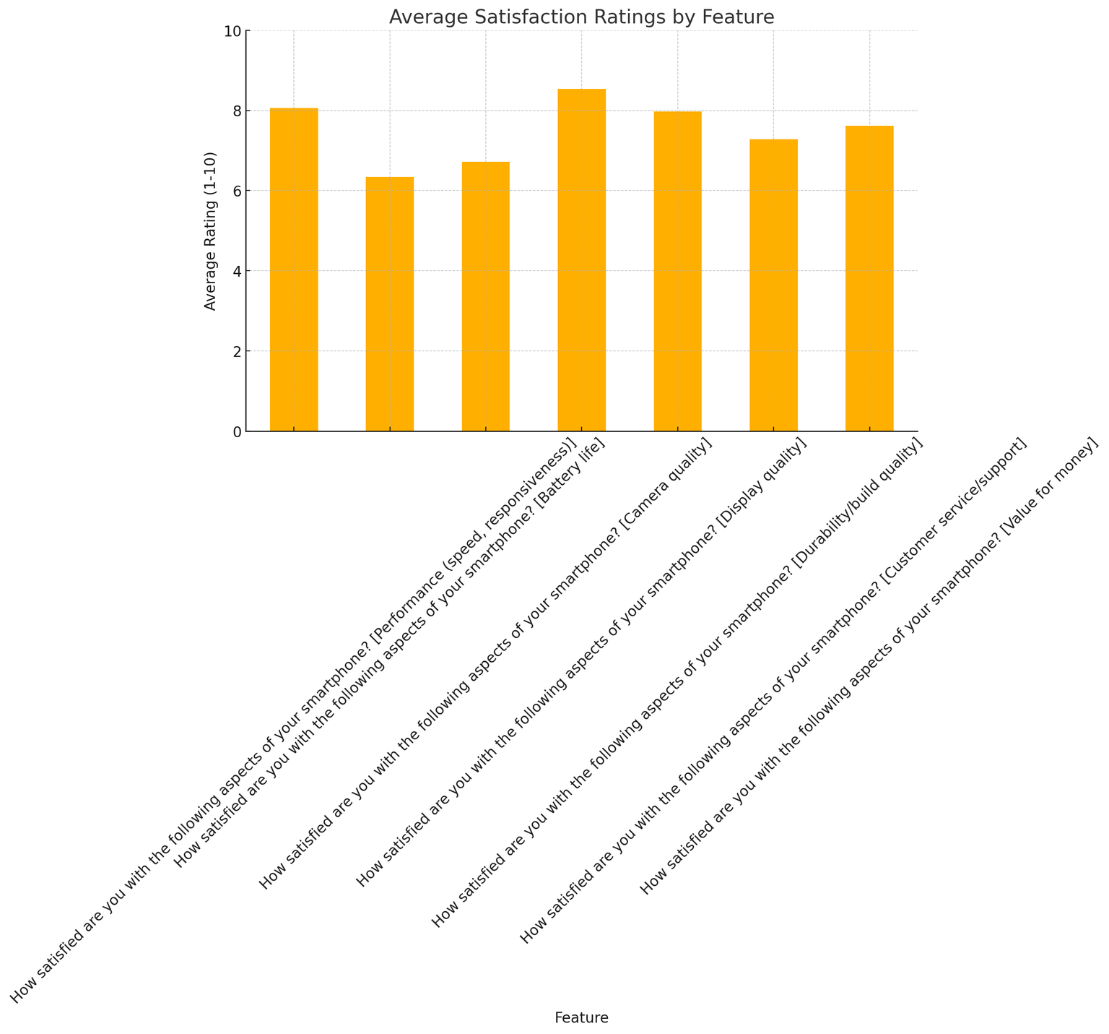

Slide 15
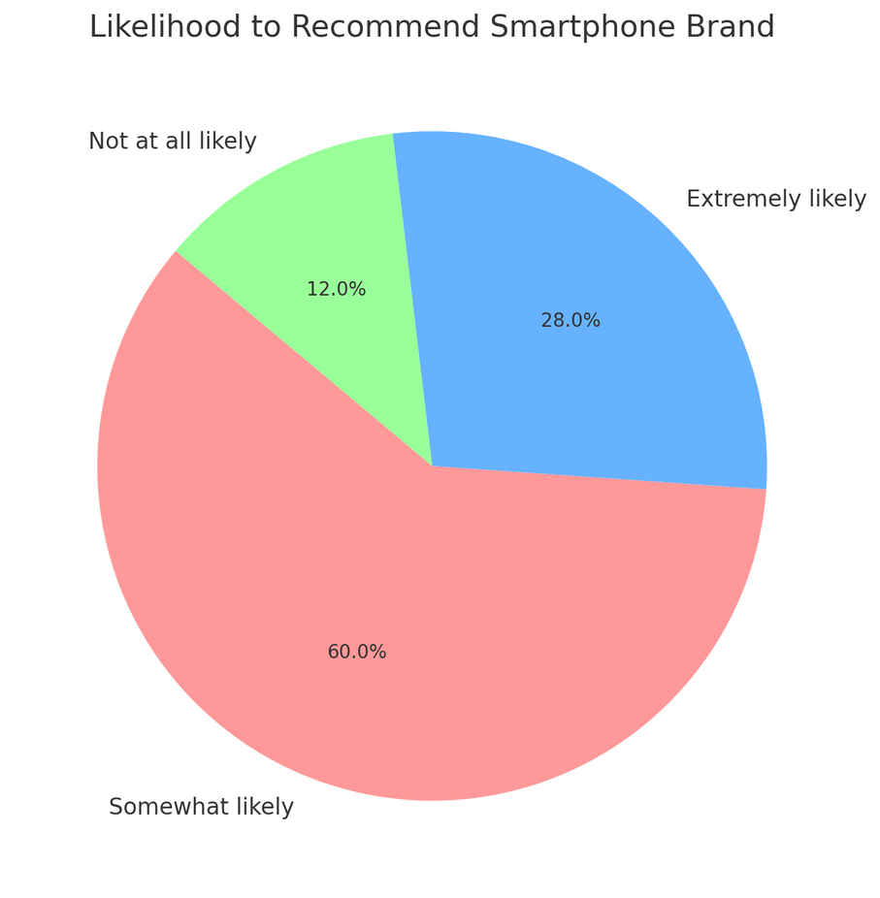
User Loyalty and Brand Recommendations
Key Insights:
Positive Recommendations:
60% of respondents are likely to recommend their brand, citing performance, camera quality, and reliability.
Premium brands like iPhone and Samsung dominate this category due to their strong reputation and consistent user satisfaction.
Neutral Responses:
25% of users are hesitant, highlighting areas for improvement like battery life and software updates.
Negative Recommendations:
15% of respondents would not recommend their brand, often due to issues like lagging performance, limited durability, or poor after-sales service.
Trends:
Users of budget brands (e.g., Redmi, Realme) are less likely to recommend their phones due to limitations in features or build quality.
Respondents who highly value performance and design are more likely to recommend their phones.

Slide 16




Factors Influencing Smartphone Brand Recommendations
Key Factors for Recommendations:
Performance:
Smooth functionality and reliability were the top reasons for positive recommendations.
Camera Quality:
High-resolution cameras made brands like iPhone and Samsung popular among respondents.
Brand Reputation:
Trust in the brand's long-term quality influences loyalty.
Design and Features:
Sleek designs and user-friendly features were noted as critical factors.
Key Factors Against Recommendations:
Battery Issues:
Frequent complaints about short battery life discouraged recommendations.
Software and Updates:
Lack of timely updates and buggy software were major drawbacks.
Durability:
Complaints about hardware failures and poor build quality impacted loyalty.
Trends:
Premium brands are more likely to receive recommendations due to consistent quality and performance.
Budget brands face challenges with durability and software updates, reducing their recommendation rates.

Slide 17
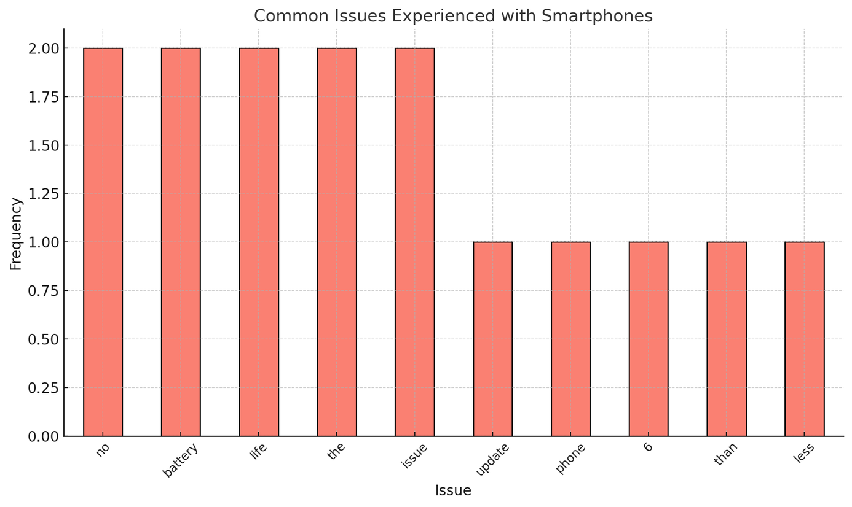
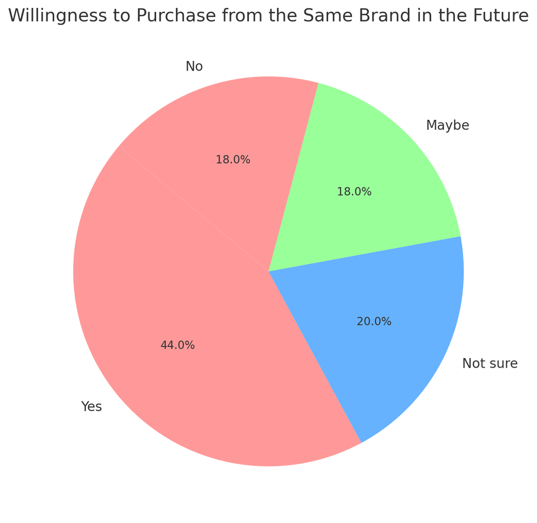
Common Issues Reported:
Battery Life:
Software Problems:
Durability Concerns:
Future Purchase Intentions:
60% of respondents are willing to repurchase the same brand due to high satisfaction with performance and features.
30% are unsure, often citing mixed experiences with durability and support.
10% will not repurchase, reflecting dissatisfaction with their current device.

Slide 18
Conclusion
Insights:
User satisfaction and loyalty are strongly tied to performance, camera quality, and software reliability.
Addressing issues like battery life and durability can improve retention for budget brands.
Key Findings
1.Brand Popularity:
Samsung, iPhone, and OnePlus are the most preferred brands, driven by performance and reputation.
Feature Usage:
Camera and social media apps dominate as the most frequently used features.
Satisfaction Ratings:
Premium brands (e.g., iPhone, Samsung) consistently scored higher on satisfaction compared to budget brands.
Challenges:
Common issues include battery life, software updates, and durability, particularly for budget devices.
Future Purchase Intentions:
60% of users are likely to repurchase the same brand, reflecting strong brand loyalty among satisfied users.

Slide 19
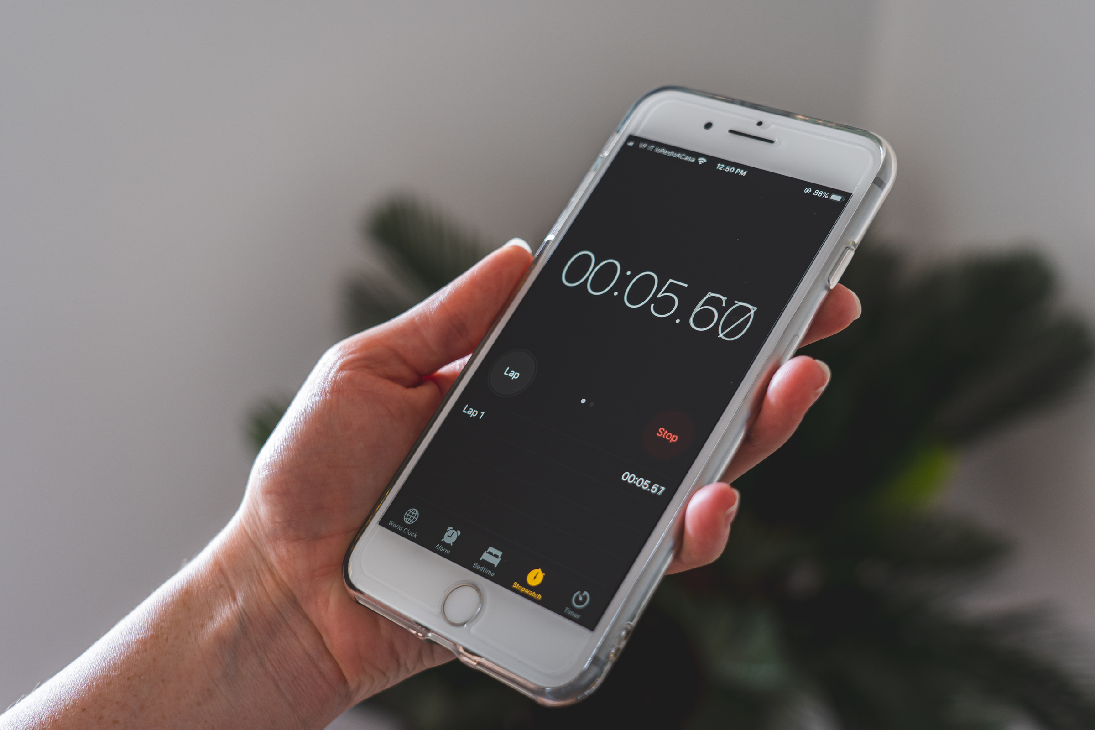
Thank you!!

